Slide 1
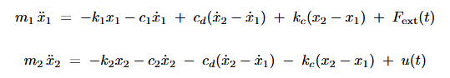
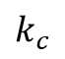
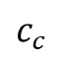
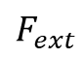
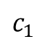
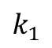
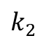
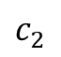
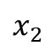
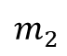
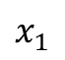
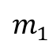
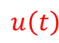
MCK active control
$$x_{1}$$
$$x_{2}$$
$$k_{1}$$
$$k_{c}$$
$$k_{2}$$
$$F_{ext}$$
$$u\left(t\right)$$
$$m_{1}$$
$$m_{2}$$
$$c_{1}$$
$$c_{c}$$
$$c_{2}$$

Slide 2
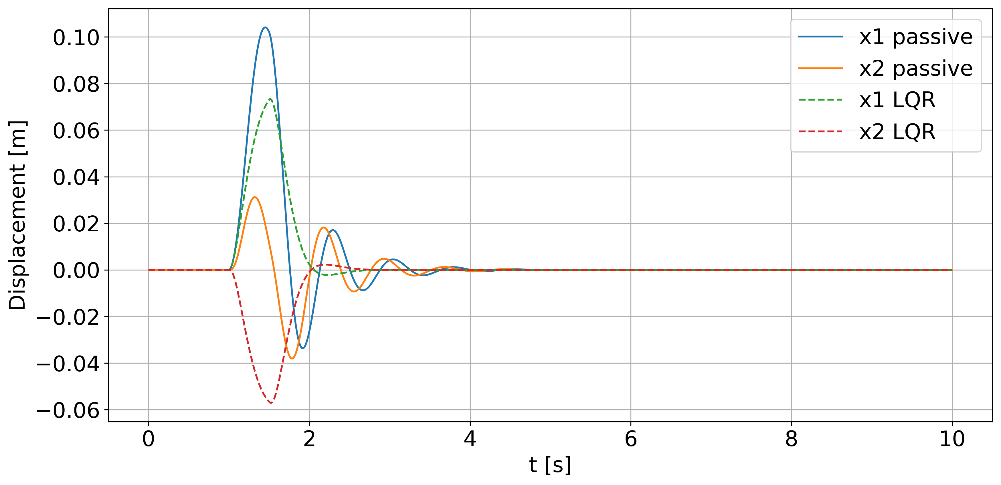
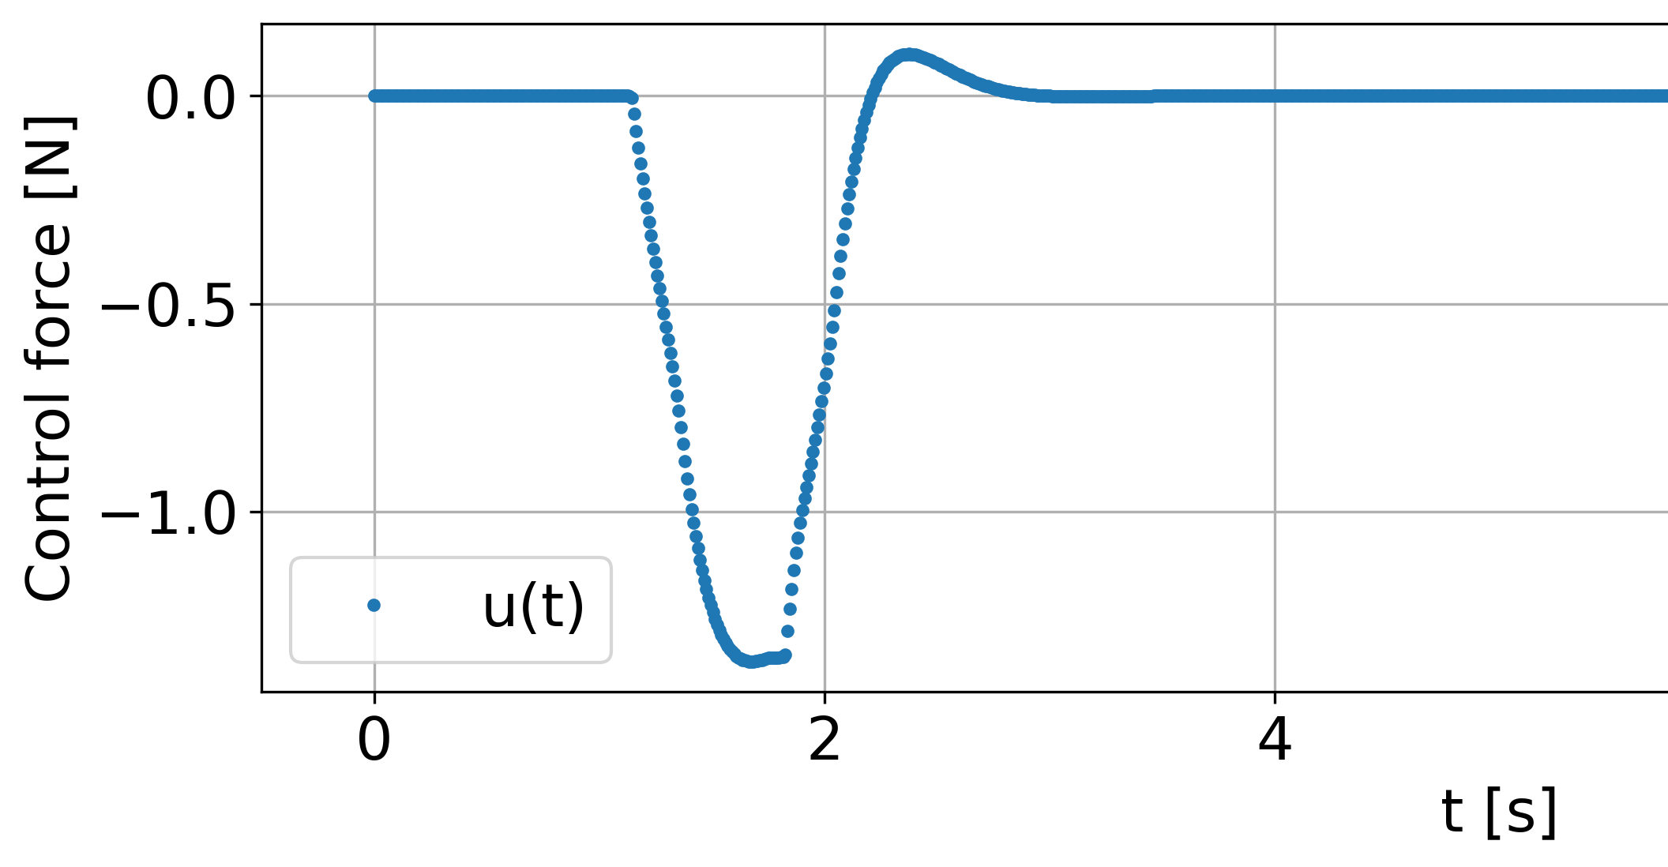
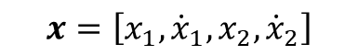

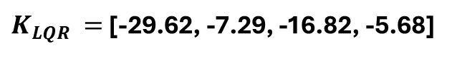
1) I found the best K with LQR.
$$x=\left[x_{1},{\dot{x}}_{1},x_{2},{\dot{x}}_{2}\right]$$
$$u=K_{LQR}x$$
$K_{LQR }=$[-29.62, -7.29, -16.82, -5.68]

Slide 3
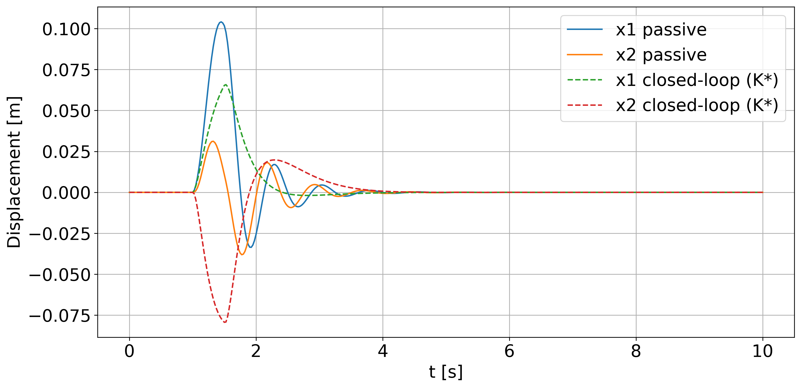
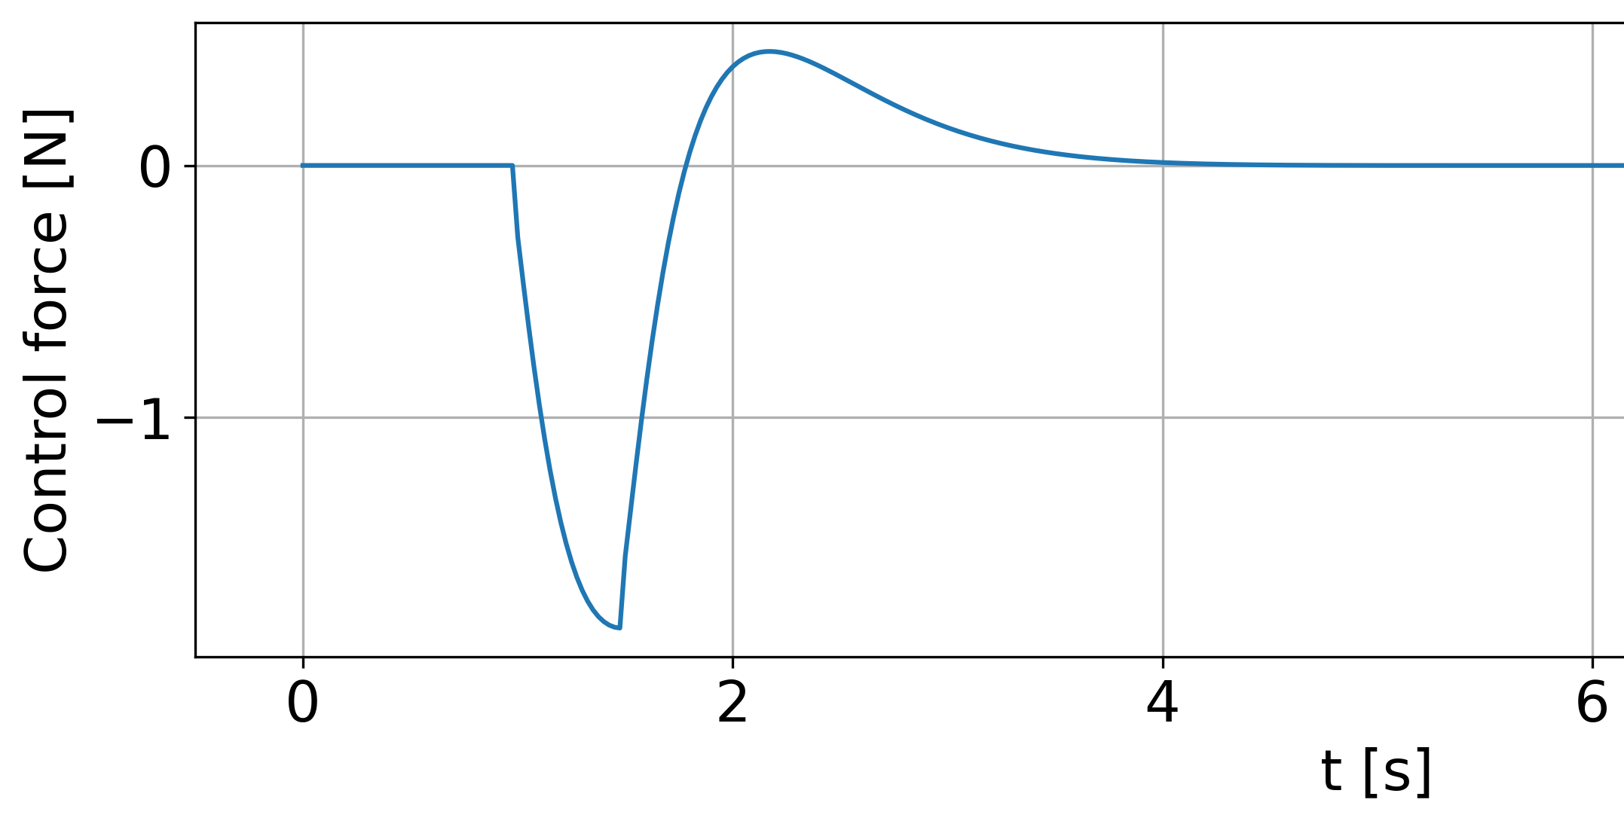
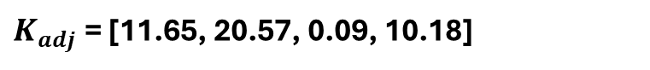
2) I set up the adjoint based optimal control to find the best K. I used L-BFGS starting with initial cond. K0=0
K0 = [0,0,0,0]
$K_{adj}$= [11.65, 20.57, 0.09, 10.18]

Slide 4
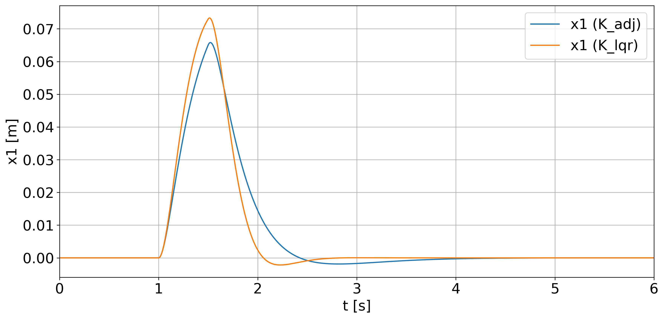
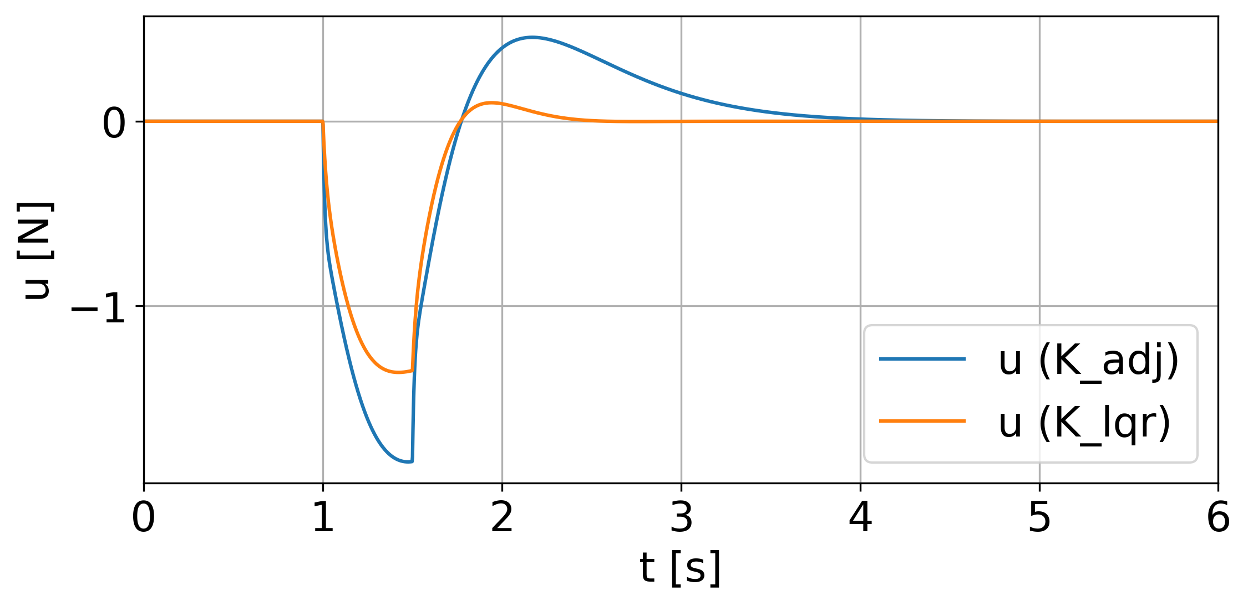
Comparison of the two results:
K_adj != K_lqr
Cost function ADJ > LQR
K_adj = [11.65, 20.57, 0.09, 10.18]
K_lqr = [29.62, 7.29, 16.82, 5.68]
Cost function: K_adj 45.09
Cost function: K_lqr 19.60

Slide 5
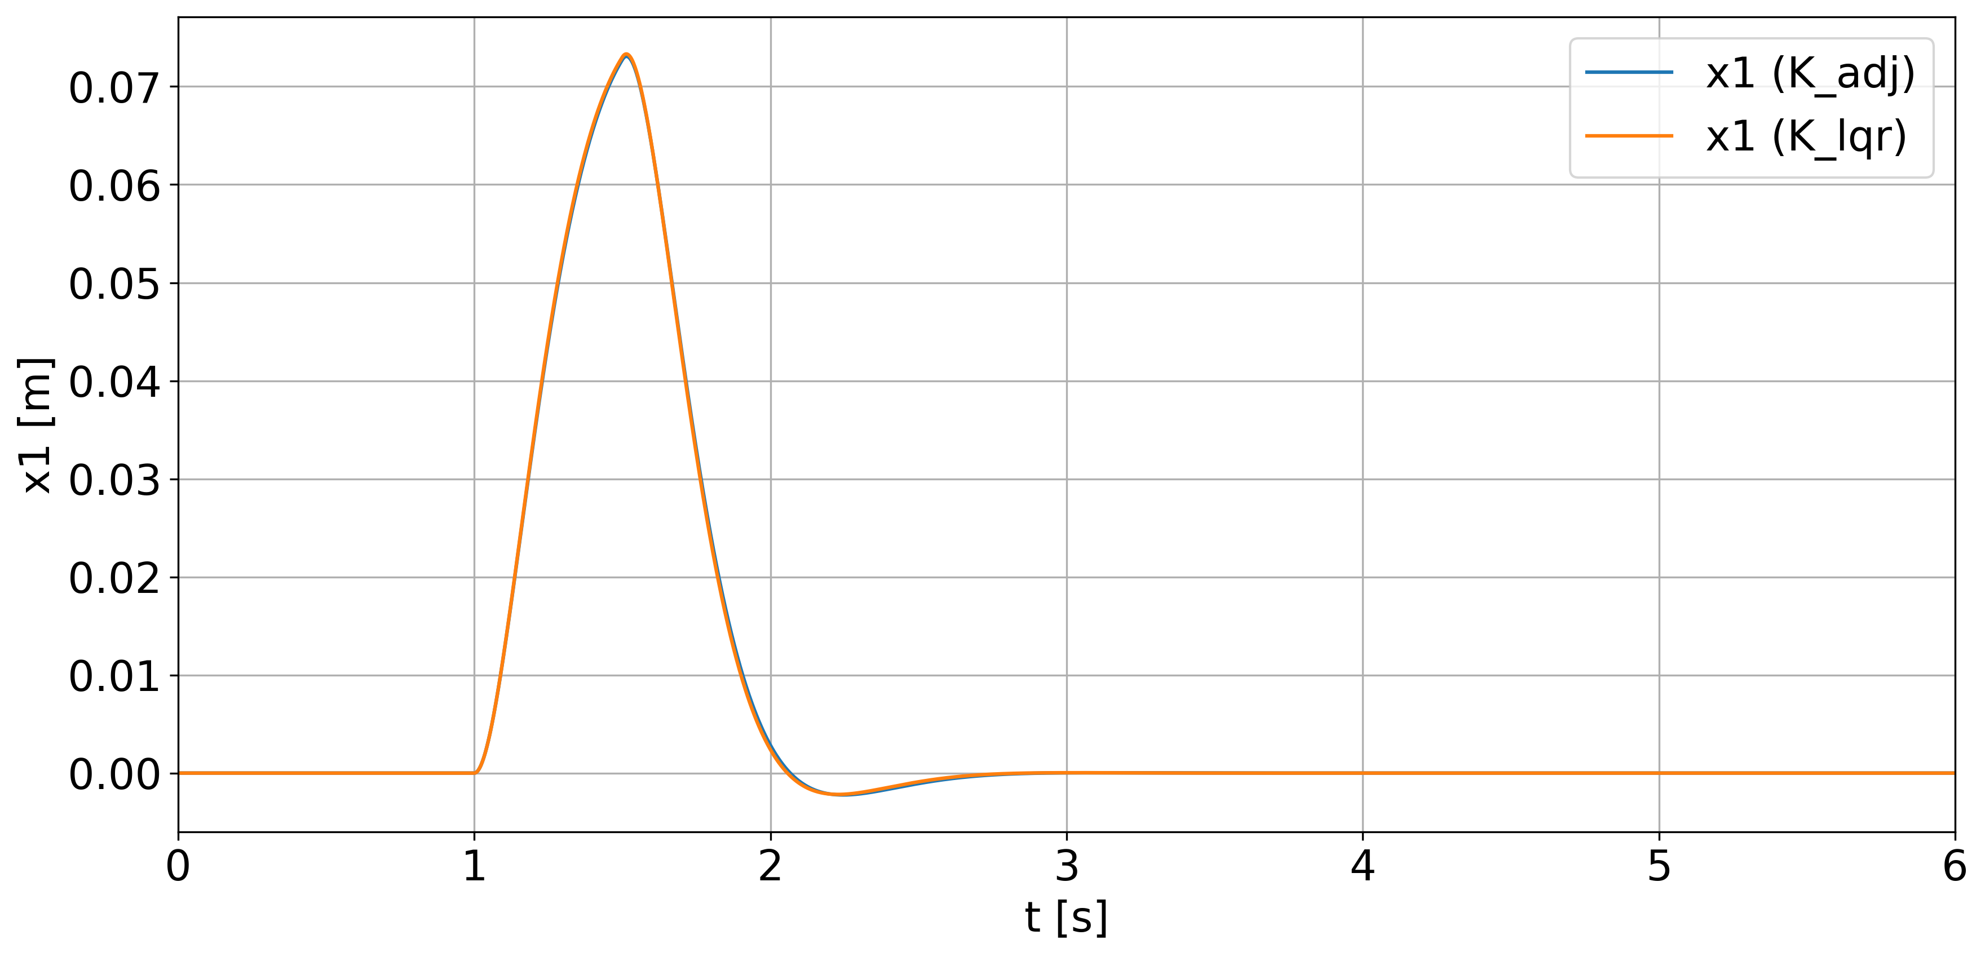
4) I restarted the L-BFGS with K0 = K_lqr
The two K are almost the same
The cost function too (adj_new a little bit better)
With BFGS I before landed in a local minima
K_adj_new =[29.65,7.47, 16.79, 5.54]
K_lqr = [29.62, 7.29, 16.82, 5.68]
Cost function: K_adj_new 19.58
Cost function: K_lqr 19.60

Slide 6
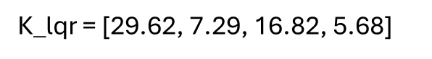
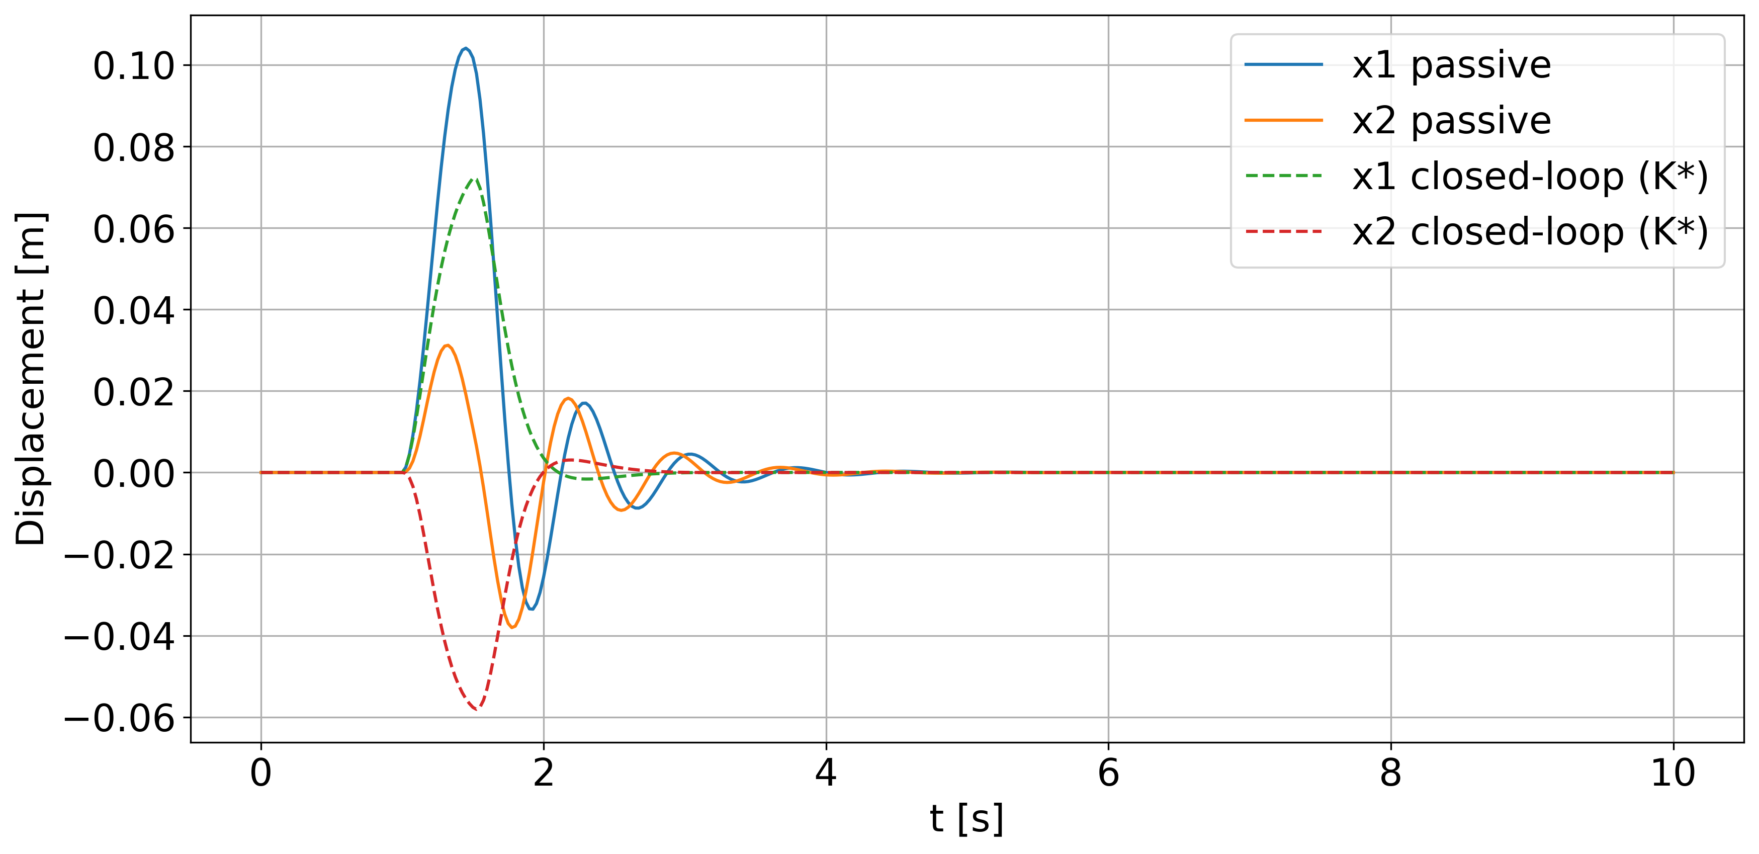
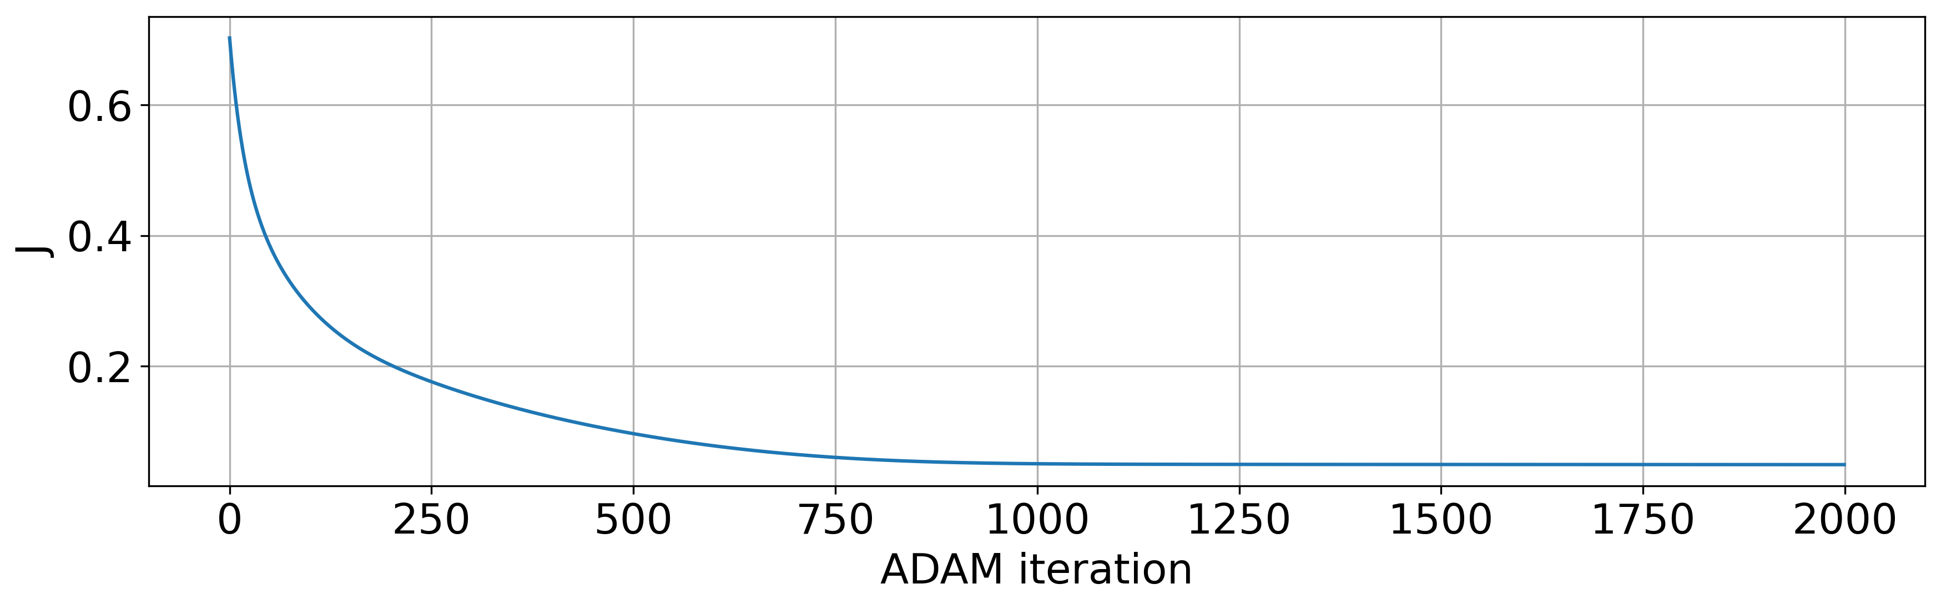
5) I used ADAM optimization to find K,
Same as before K0 = 0
K_adj != K_lqr
K0 = [0,0,0,0]
K_adj_adam = [10.3 ,3.79 ,-8.40,1.06]

Slide 7
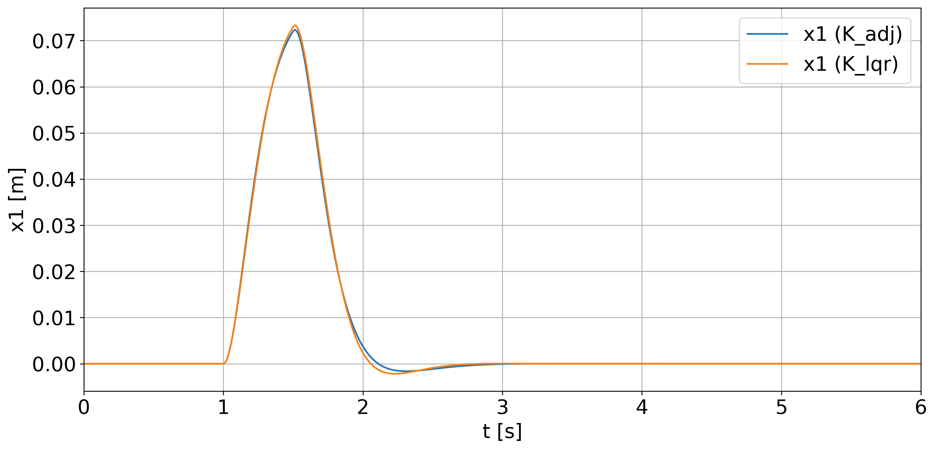
6) Comparison with ADJ_adam and LQR
K_ADJ_adam != K_LQR
BUT
Cost function ADJ_adam almost same of LQR
EVEN IF K is VERY different
→ There are more combination of K_i that try to minimize the cost func
K_adj = [10.3 ,3.79 ,-8.40,1.06]
K_lqr = [29.62, 7.29, 16.82, 5.68]
Cost function: K_adj_Adam 19.73
Cost function: K_lqr 19.60

Slide 8
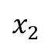
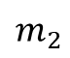
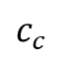
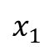
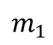
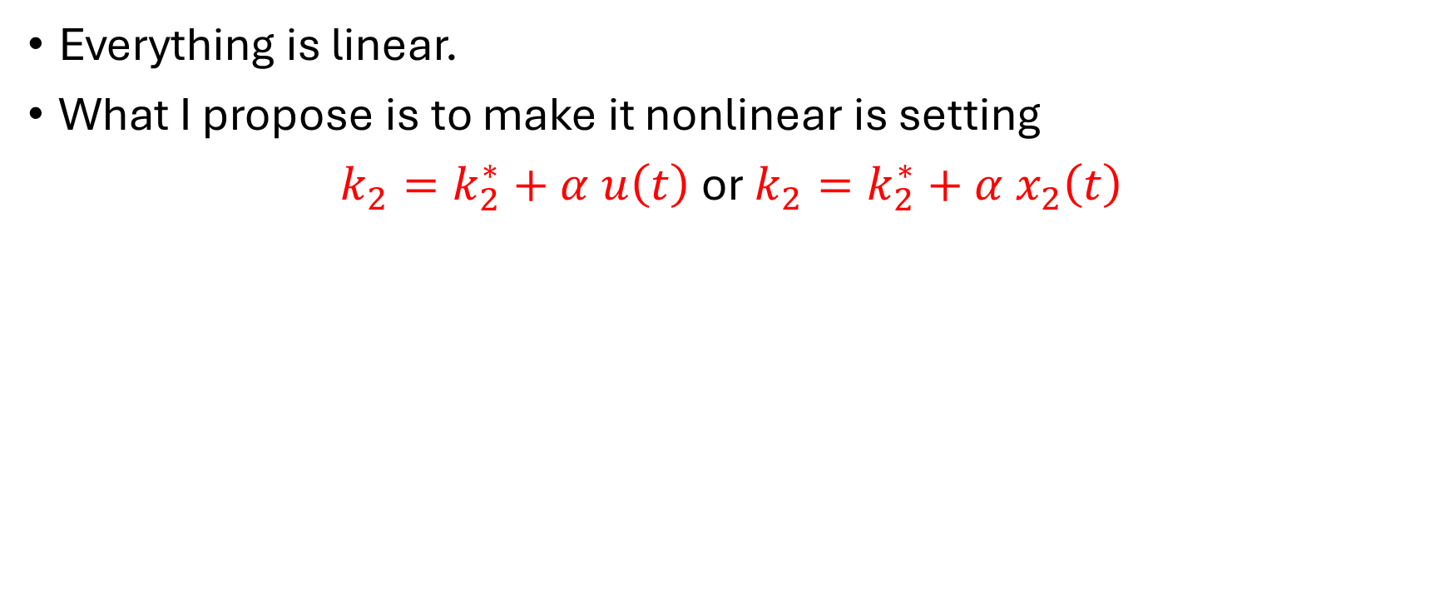
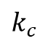
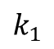
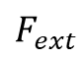
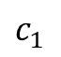
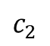
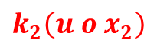
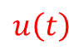
So,
Everything is linear.
What I propose is to make it nonlinear is setting
$k_{2}=k_{2}^{∗}+α u\left(t\right)$or $k_{2}=k_{2}^{∗}+α x_{2}\left(t\right)$
$$x_{1}$$
$$x_{2}$$
$$k_{1}$$
$$k_{2}\left(u o x_{2}\right)$$
$$k_{c}$$
$$F_{ext}$$
$$u\left(t\right)$$
$$m_{1}$$
$$m_{2}$$
$$c_{1}$$
$$c_{c}$$
$$c_{2}$$
**I can justify saying
if I increase the pressure in the piston I put some Force but also increase the stiffness of the equivalent mechanical model

Slide 9
To do
Same cost function for LQr and ajdj
Prima parte LQR vs. adj stessa cost function, utilizzare 2 K_i, x1 and x2 o togliere solo x2_Dot
Lqr non si può usare pìu legge di controllo
O Sistema non lineare, o cost function non è la quadratica o legge di attuazione non lineare

Slide 10
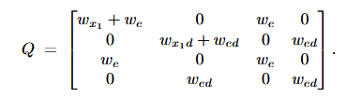
Cost function adjoint
Q of LQR

Slide 11
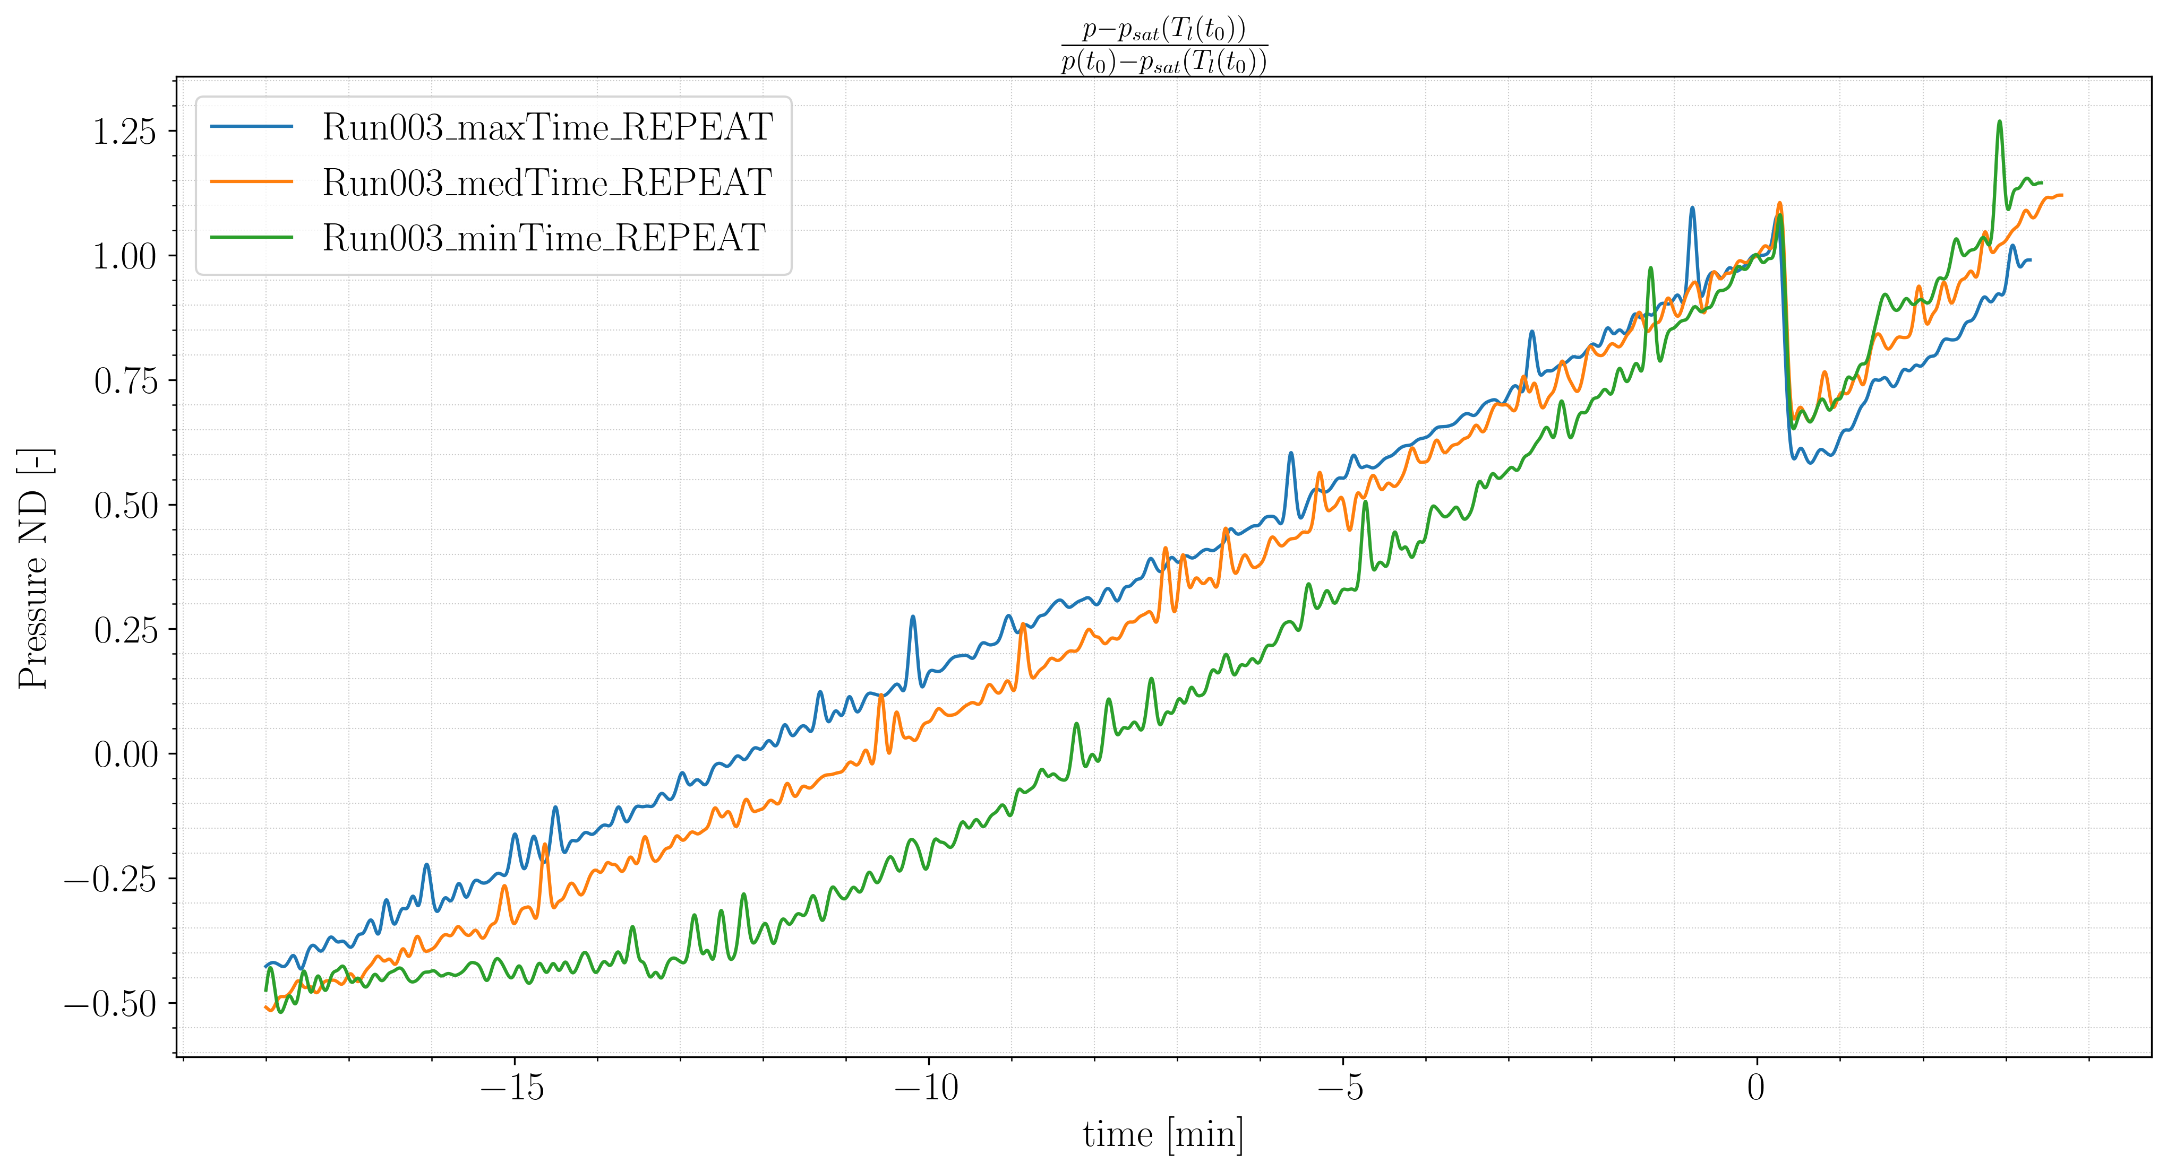
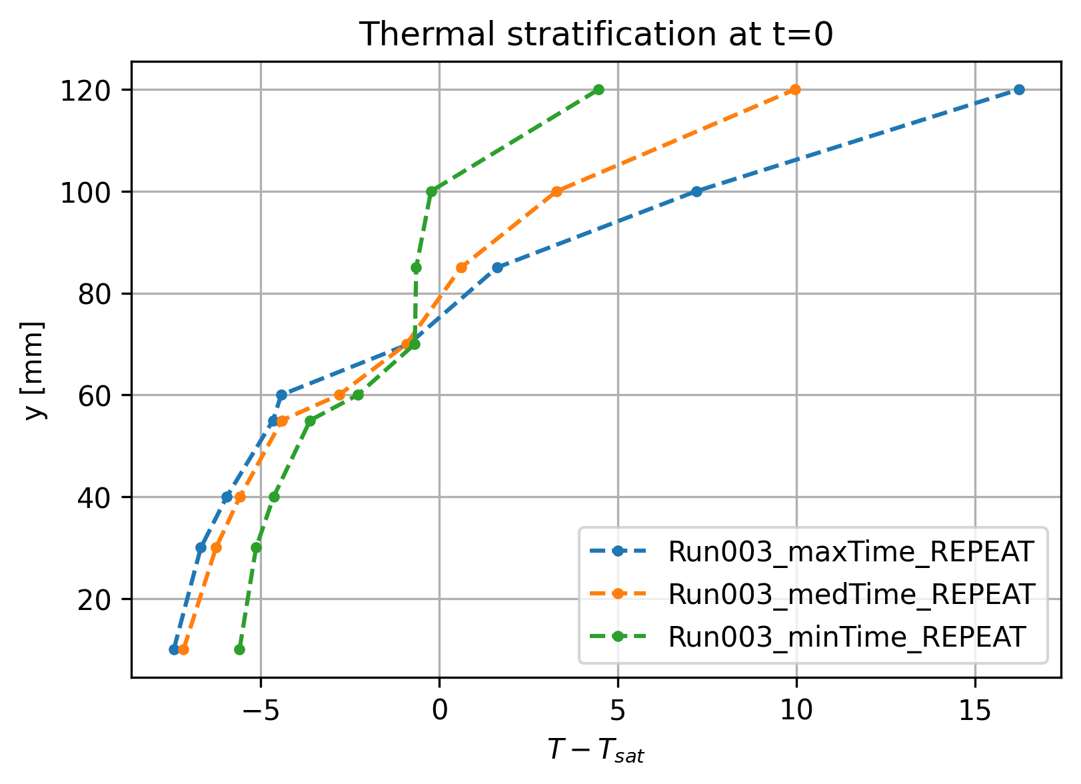
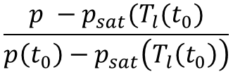
Non-isothermal sloshing?
$$\frac{p −p_{sat}(T_{l}(t_{0})}{p\left(t_{0}\right)−p_{sat}\left(T_{l}\left(t_{0}\right)\right)}$$

Slide 12
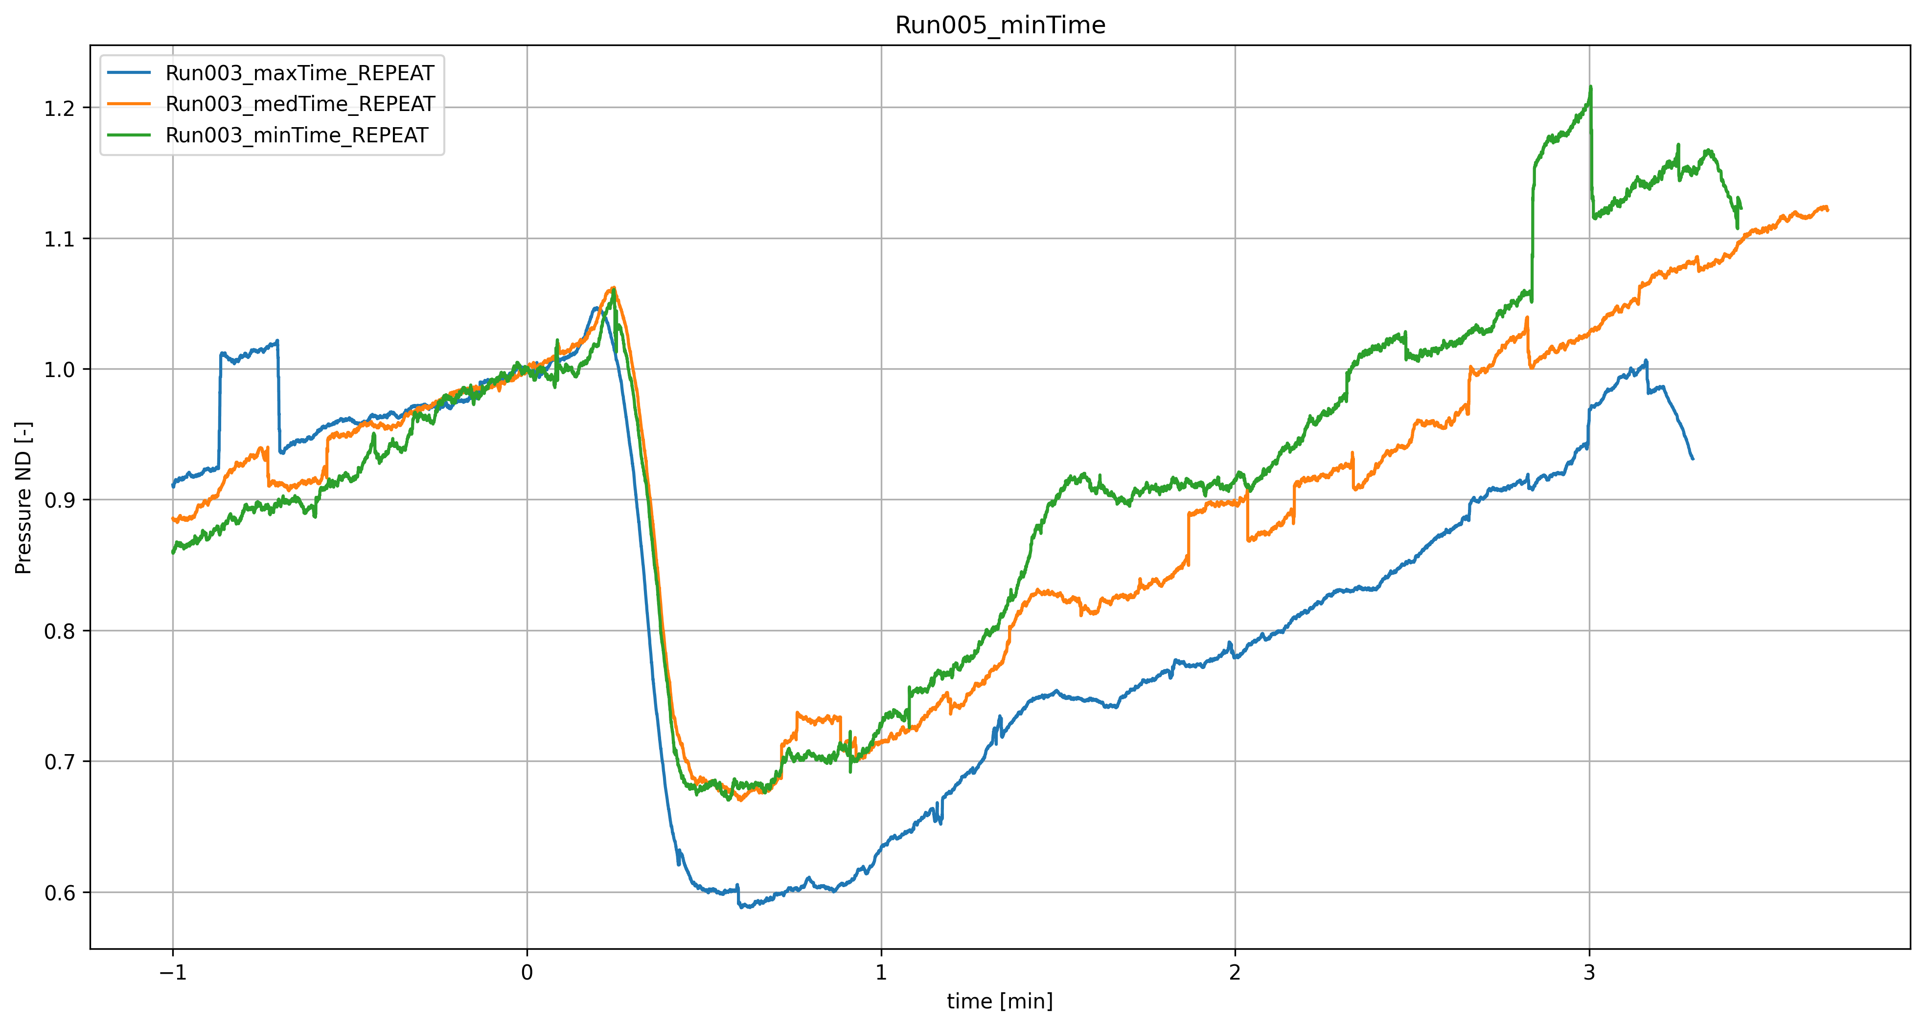
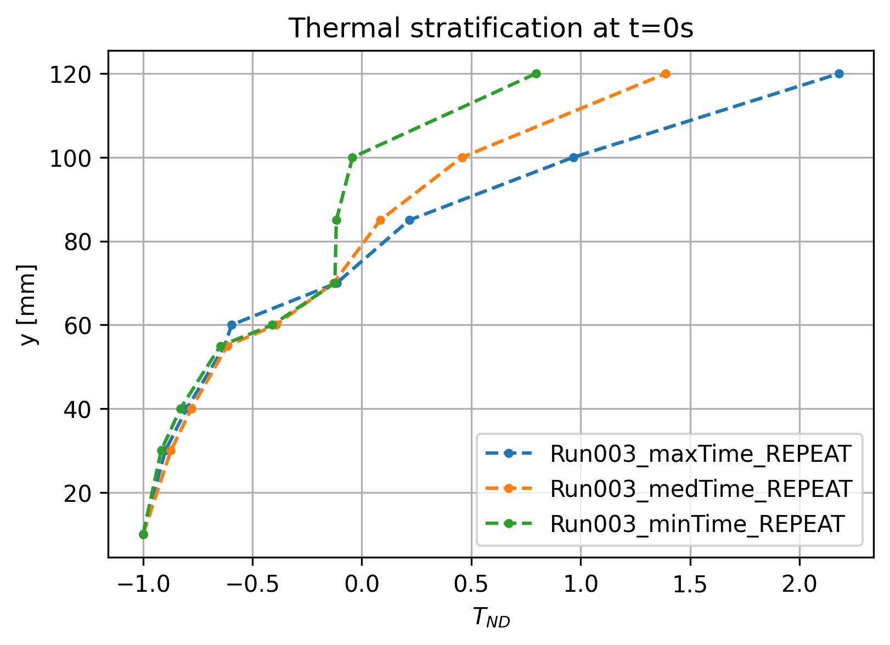
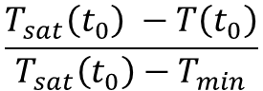
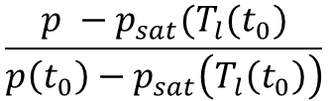
Non-isothermal sloshing?
$$\frac{p −p_{sat}(T_{l}(t_{0})}{p\left(t_{0}\right)−p_{sat}\left(T_{l}\left(t_{0}\right)\right)}$$
$$\frac{T_{sat}\left(t_{0}\right) −T\left(t_{0}\right)}{T_{sat}\left(t_{0}\right)−T_{min}}$$

Slide 13
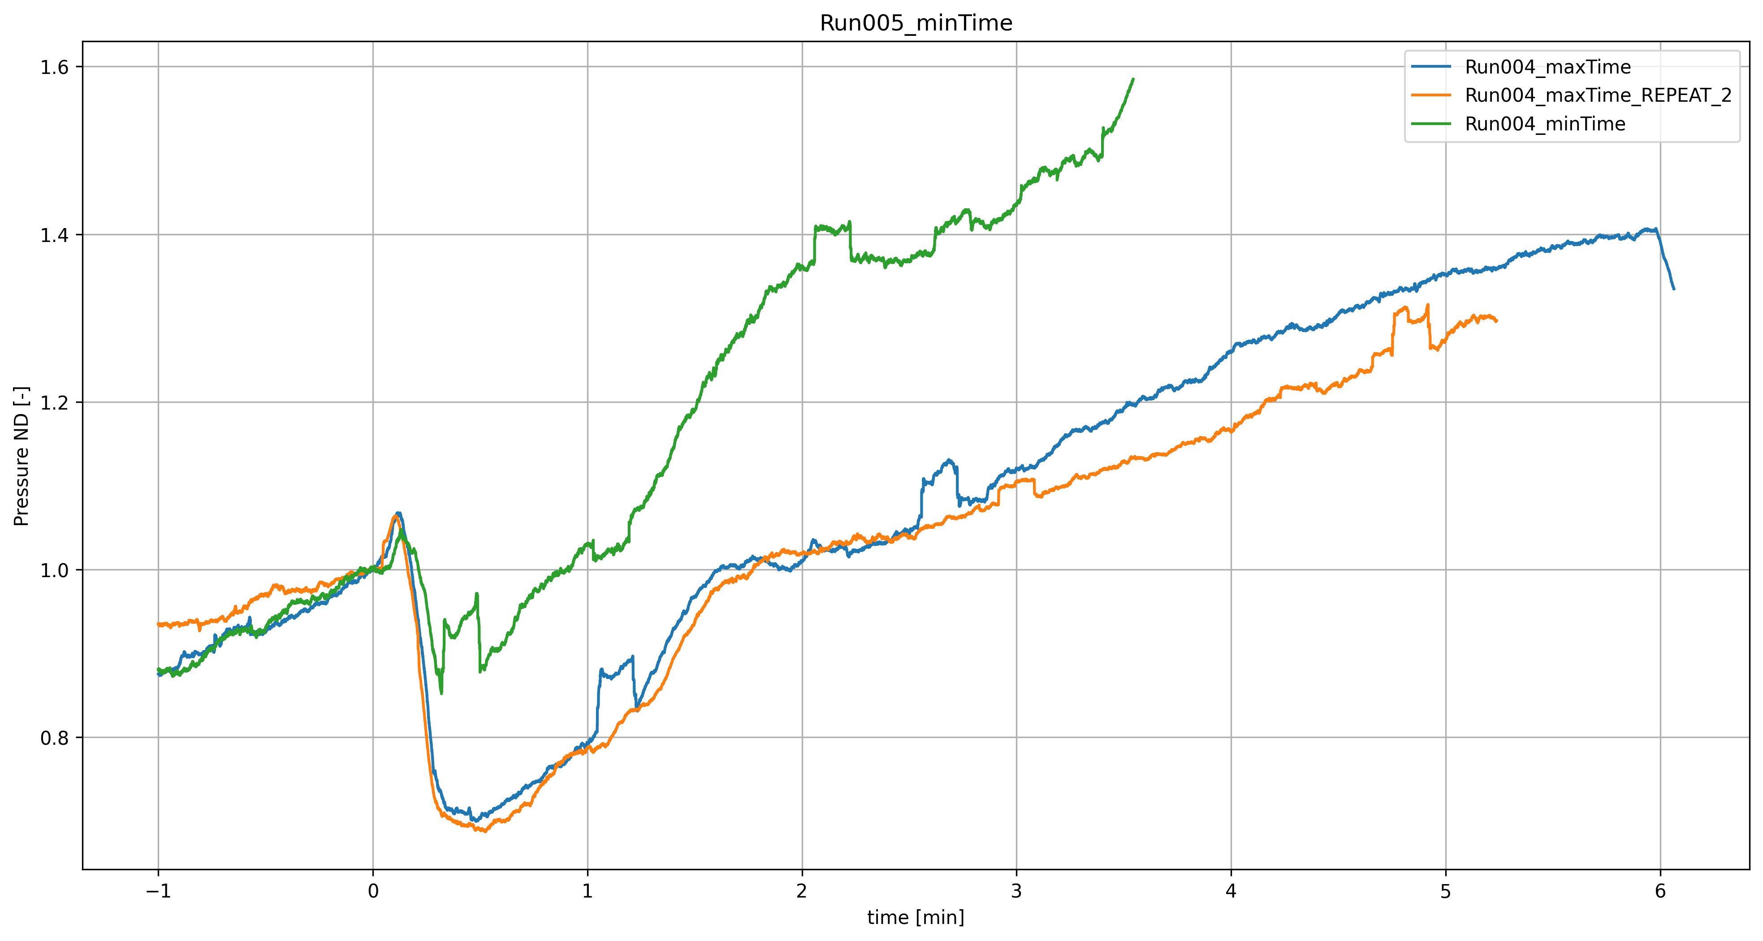
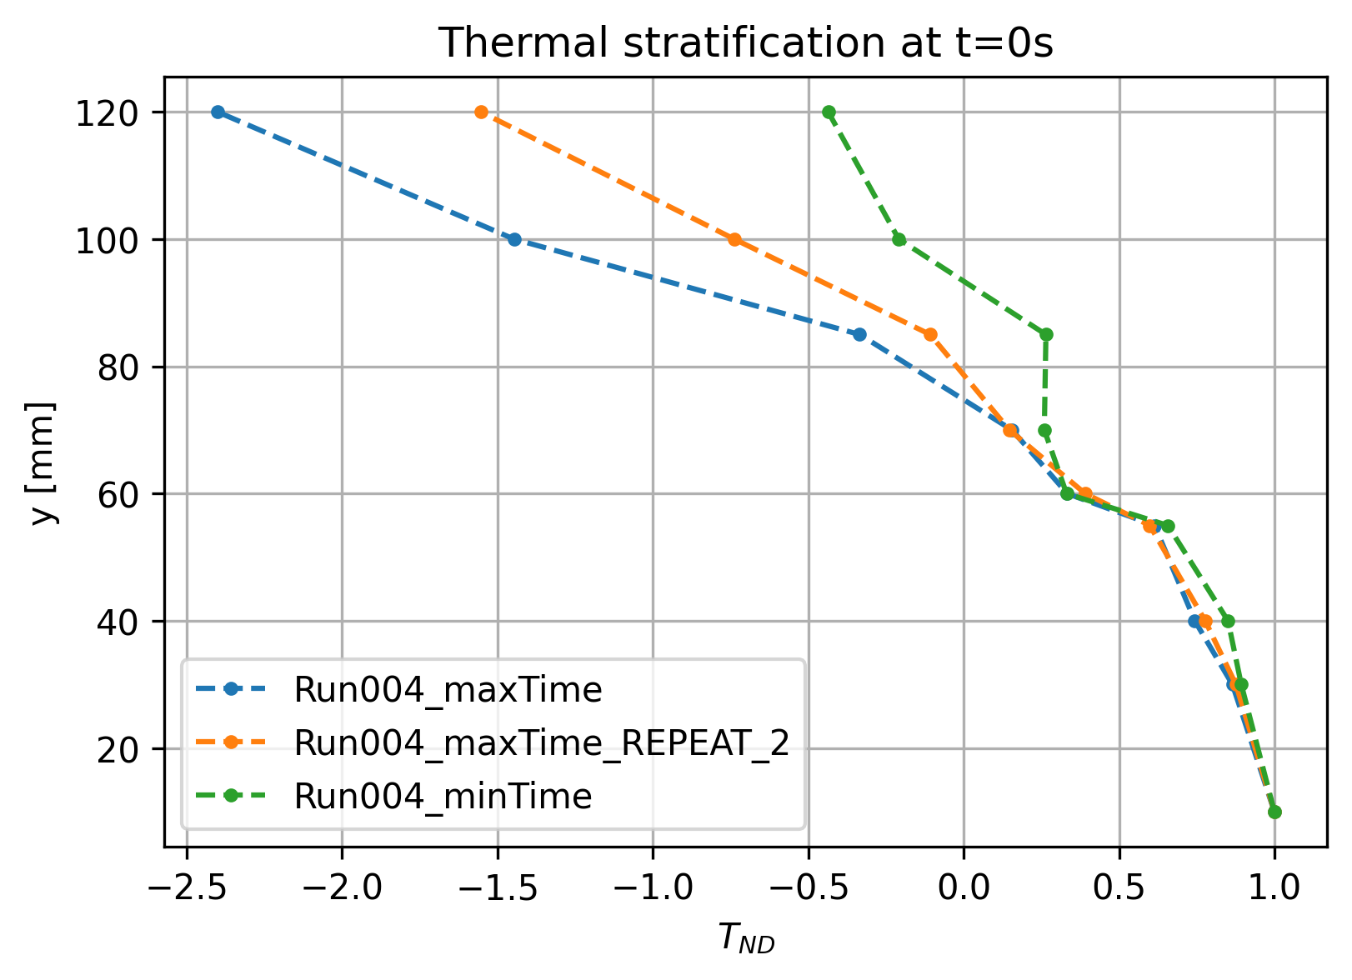
Other case: Run004
The green I will repeat….
$$\frac{p −p_{sat}(T_{l}(t_{0})}{p\left(t_{0}\right)−p_{sat}\left(T_{l}\left(t_{0}\right)\right)}$$
$$\frac{T_{sat}\left(t_{0}\right) −T\left(t_{0}\right)}{T_{sat}\left(t_{0}\right)−T_{min}}$$

Slide 14


I found the best K with LQR.
LQR can only found the best K function to the entire state x
$$x=\left[x_{1},{\dot{x}}_{1},x_{2},{\dot{x}}_{2}\right]$$
$$u=K_{LQR}x$$
$K_{LQR }=$[29.13 ,7.449 ,19.484 ,5.736]

Slide 15




2) Adjoint with JAX using the full state
$$u=\left[ K_{1},K_{2},K_{3},K_{4}\right]{\left[x\right]}^{T}$$
K_opt = [14.54, 10.12, - 0.2008, 8.0320]
K1 and K3
K2 and K4

Slide 16







2) Adjoint with JAX using the full state Adjoint implementation
Start with a K, compute the trajectory X with this K
Compute Cost from this trajectory
Backward integration of $\dot{λ}$
$$J= \int_{0}^{T}{L}$$
Where $\frac{∂f }{∂x}=A+BK$
$$\frac{∂L}{∂x}=2w_{x1}x_{1}+…$$

Slide 17




5. Computation of the gradient
$$\frac{∂f}{∂u}=B^{T}$$
Where $\frac{∂L}{∂u} =2 r_{u} u$
$$\frac{∂u}{∂K}=x$$
And then Adam with optax ecc…

Slide 18


3) Adjoint with JAX using only x1,x1d
K_full_opt = [-13.65 -3.025 0. 0. ]

Slide 19



4)Comparison LINEAR case

Slide 20




3) Adjoint with JAX using only x1,x1d in a nonlinear system cubic spring $k_{3}$
k3

Slide 21



3) Adjoint with JAX using only x1,x1d in a nonlinear system → $k_{2}=k_{2}^{∗}+α u\left(t\right)$
K = [-10.712 -2.734 ,0,0]

Slide 23


3) Adjoint with JAX using only x1,x1d in a nonlinear system → $k_{2}=k_{2}^{∗}+α u\left(t\right)$ Adjoint implementation

